Slide 1
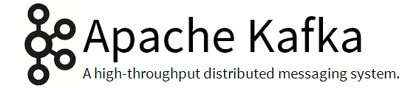

Slide 2
History
Originated at LinkedIn, open source in early 2011
Implemented in Scala, some java
http://kafka.apache.org/

Slide 3
Kafka adoption and use cases
LinkedIn – activity streams
Netflix -real-time monitoring and event processing
Twitter – Storm real time data pipelines
Spotify – log delivery
Loggly – log collection and processing

Slide 4
What is Kafka ?
A fast, scalable, fault-tolerant messaging system
Publish-subscribe
Kafka is often used in place of traditional message brokers like JMS and AMQP because of its higher throughput, reliability and replication.

Slide 5
What kafka does ?
Stream Processing
Website Activity Tracking
Metrices Collection
Log Aggregation
Notes:
Website activity tracking: The web application sends events such as page views and searches Kafka, where they become available for real-time processing, dashboards and offline analytics in Hadoop
Operational metrics: Alerting and reporting on operational metrics. One particularly fun example is having Kafka producers and consumers occasionally publish their message counts to a special Kafka topic; a service can be used to compare counts and alert if data loss occurs.
Log aggregation: Kafka can be used across an organization to collect logs from multiple services and make them available in standard format to multiple consumers, including Hadoop and Apache Solr.
Stream processing: A framework such as Spark Streaming reads data from a topic, processes it and writes processed data to a new topic where it becomes available for users and applications. Kafka’s strong durability is also very useful in the context of stream processing.

Slide 6
Features of Kafka
Scalability
Durability
Reliability
Performance
Notes:
Scalability
Distributed system scales easily with no downtime
Durability
Persists messages on disk, and provides intra-cluster replication
Reliability
Replicates data, supports multiple subscribers, and automatically balances consumers in case of failure
Performance
High throughput for both publishing and subscribing, with disk structures that provide constant performance even with many terabytes of stored messages

Slide 7
Use Cases
Kafka works is combination with -
Apache Storm
Apache Hbase
Apache Spark
for real time analysis and rendering of streaming data

Slide 8
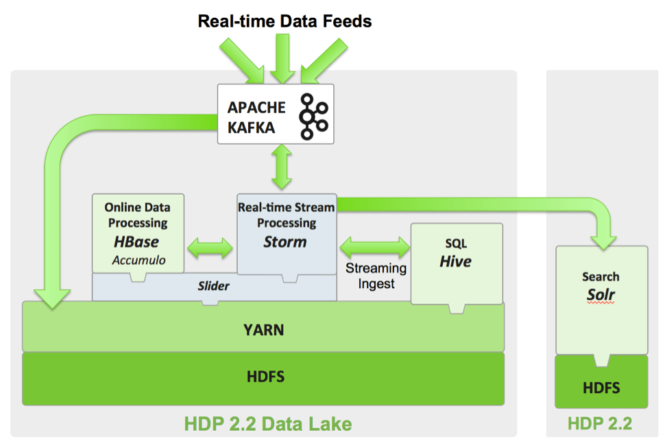
Use Cases

Slide 9
How Kafka Works
There are four main components involved in moving data in and out of Kafka:
Topics
Producers
Consumers
Brokers
Notes:
In Kafka, a Topic is a user-defined category to which messages are published. Kafka Producers publish messages to one or more topics and Consumers subscribe to topics and process the published messages. Finally, a Kafka cluster consists of one or more servers, called Brokers that manage the persistence and replication of message data (i.e. the commit log).

Slide 10
How Kafka Works
Producers writes data to brokers.
Consumer read data from brokers.
Data is stored in topics.
Topics are split into partitions, which are replicated.
Notes:
In Kafka, a Topic is a user-defined category to which messages are published. Kafka Producers publish messages to one or more topics and Consumers subscribe to topics and process the published messages. Finally, a Kafka cluster consists of one or more servers, called Brokers that manage the persistence and replication of message data (i.e. the commit log).

Slide 11
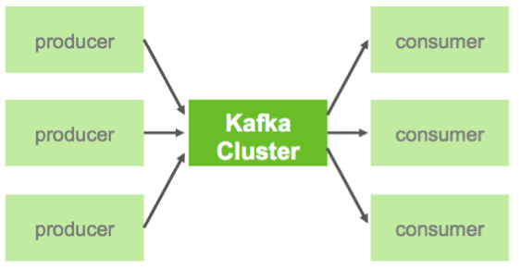
How Kafka Works

Slide 12
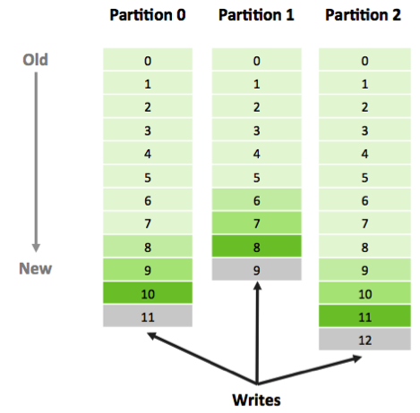
How Kafka Works
Notes:
In Kafka, topics consist of one or more Partitions that are ordered, immutable sequences of messages that is continually appended to—a commit log..
Another factor contributing to Kafka’s performance and scalability is the fact that Kafka brokers are not responsible for keeping track of what messages have been consumed – that responsibility falls on the consumer.
In traditional messaging systems such as JMS, the broker bore this responsibility, severely limiting the system’s ability to scale as the number of consumers increased.

Slide 13
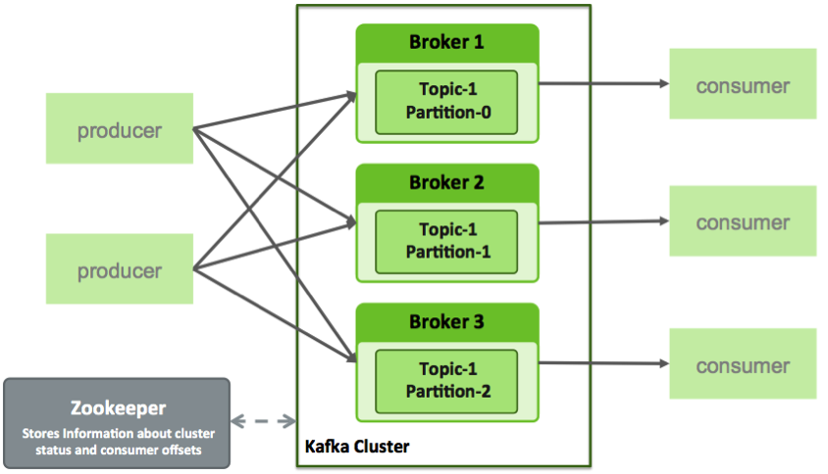
How Kafka Works
Notes:
For Kafka consumers, keeping track of which messages have been consumed (processed) is simply a matter of keeping track of an Offset, which is a sequential id number that uniquely identifies a message within a partition.

Slide 14
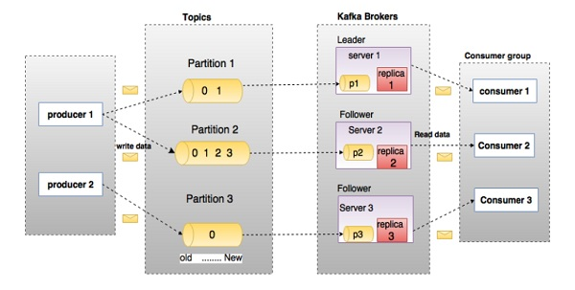
How Kafka Works
Notes:
For Kafka consumers, keeping track of which messages have been consumed (processed) is simply a matter of keeping track of an Offset, which is a sequential id number that uniquely identifies a message within a partition.

Slide 15
Why Zookeeper ?
Zookeeper stores below meta data information.
List of brokers
List of topics
List of replicas of a topic
Consumer offset
Notes:
For Kafka consumers, keeping track of which messages have been consumed (processed) is simply a matter of keeping track of an Offset, which is a sequential id number that uniquely identifies a message within a partition.

Slide 16
Things to know about Kafka...
The Kafka cluster retains all published messages—whether or not they have been consumed—for a configurable period of time.
Messages sent by a producer to a particular topic partition will be appended in the order they are sent.
A consumer instance sees messages in the order they are stored in the log.

Slide 17
Distribution
The Partitions are distributed over the servers in the Kafka cluster.
Each partition is replicated across a configurable number of servers for fault tolerance.
Each partition has one server which acts as the "leader" and zero or more servers which act as "followers".

Slide 18
Distribution
The leader handles all read and write requests for the partition while the followers passively replicate the leader.
If the leader fails, one of the followers will automatically become the new leader.
Each server acts as a leader for some of its partitions and a follower for others so load is well balanced within the cluster.

Slide 19
How to use Kafka ?
Step – 1 : Download the code -
> tar -xzf kafka_2.11-0.9.0.0.tgz
> cd kafka_2.11-0.9.0.0
Step -2 : Start the server -
Kafka uses ZooKeeper so you need to first start a ZooKeeper server if you don't already have one.
bin/zookeeper-server-start.sh config/zookeeper.properties
bin/kafka-server-start.sh config/server.properties

Slide 20
How to use Kafka ?
Step – 3 : Create a Topic -
>> bin/kafka-topics.sh --create --zookeeper localhost:2181 --replication-factor 1 --partitions 1 --topic test
Step - 4 : Test the Topic -
>> bin/kafka-topics.sh --list --zookeeper localhost:2181

Slide 21
How to use Kafka ?
Step – 5 : Send some messages -
>> bin/kafka-console-producer.sh --broker-list localhost:9092 --topic test
Step - 6 : Start a Consumer -
>> bin/kafka-console-consumer.sh --zookeeper localhost:2181 --topic test --from-beginning

Slide 22
Demo

Slide 23
Setting up a multi-broker cluser
>> cp config/server.properties config/server-1.properties
>> cp config/server.properties config/server-2.properties
config/server-1.properties:
broker.id=1
port=9093
log.dir=/tmp/kafka-logs-1
config/server-2.properties:
broker.id=2
port=9094
log.dir=/tmp/kafka-logs-2

Slide 24
Setting up a multi-broker cluser
>> bin/kafka-server-start.sh /usr/local/kafka/config/server-1.properties &
>> bin/kafka-server-start.sh /usr/local/kafka/config/server-2.properties &
> bin/kafka-topics.sh --create --zookeeper localhost:2181 --replication-factor 3 --partitions 1 --topic my-replicated-topic
> bin/kafka-topics.sh --describe --zookeeper localhost:2181 --topic my-replicated-topic

Slide 25
Setting up a multi-broker cluser
>> bin/kafka-console-producer.sh --broker-list localhost:9092 --topic my-replicated-topic
>> bin/kafka-console-consumer.sh --zookeeper localhost:2181 --from-beginning --topic my-replicated-topic
Now let's test out fault-tolerance. Broker 1 was acting as the leader so let's kill it:
> ps -ef | grep server-1.properties
> kill -9 <id>

Slide 26
Setting up a multi-broker cluser
Leadership has switched to one of the slaves and node 1 is no longer in the in-sync replica set:
> bin/kafka-topics.sh --describe --zookeeper localhost:2181 --topic my-replicated-topic
> bin/kafka-console-consumer.sh --zookeeper localhost:2181 --from-beginning --topic my-replicated-topic

